Slide 1
The Mediator Pattern

Slide 2
The Problem
“The system has lots of reusable components, which interact with each other. But the dependencies between the components are starting to become hard to maintain.”
Notes:
The Problem
There are lots of good practices we could talk about here to help us here. But what it boils down to is, if a system is being constantly developed and there is no time for maintenance then you will end up with a Big Pile of Mud.

Slide 3
The Solution
The Mediator
Encapsulates how objects interact
Promotes loose coupling
Simplifies the relationships of objects
Notes:
The Mediator pattern is a behavioural pattern, which defines an object that encapsulates how a set of objects interact.
It promotes loose coupling by keeping the objects from referencing each other
The Mediator simplifies the relationships between objects by being a single point of communication.

Slide 4
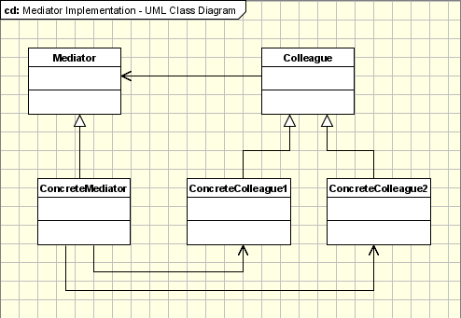
The Participants
http://www.oodesign.com/images/design_patterns/mediator_implementation_-_uml_class_diagram.gif
Notes:
The Mediator
Knows about the Colleague classes
Coordinates the communication between the Colleagues
The Colleague
References its Mediator
Communicates only with the Mediator

Slide 5

A Real World Analogy
http://www.zwink.com/data/photos/367_1_jdz_ps1_045.jpg
Notes:
The Air Traffic Controller
Could you imagine what it would be like if the planes at an airport had to talk to each other so they can all land safely?
The Air Traffic Control Tower at an air port is the Mediator object, in this analogy. The tower communicates with and coordinates the aircraft so they land safely.

Slide 6
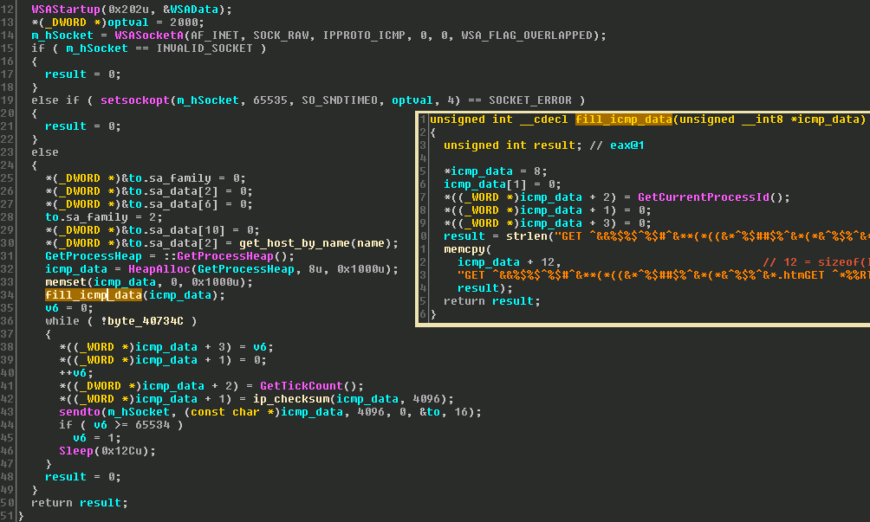
C# Example
http://www.microsoft.com/security/portal/blog-images/nitol/nitol-fig4.png
Notes:
Code Example – Chat Room
More Advanced Example – Event/Message Dispatcher
The Handlers are the colleagues and there can be many of them per Event or Message.
The Mediator is the Dispatcher, It can register and remove Handlers and looks up the Handlers for the Event / Messages.

Slide 7
Advantages \ Disadvantages
Advantages
Excellent at decoupling
Reduces relationships from "many-to-many" to "many-to-one"
Disadvantages
Introduces a single point of failure
Could introduce a performance hit
Notes:
Advantages
Colleagues (or peers) are not coupled to one another. Each talks to the Mediator, which in turn knows and conducts the orchestration of the others. The "many to many" mapping between colleagues that would otherwise exist, has been reduced to a Many-to-one.
Disadvantages
If there are any bugs or issues with the Mediator object. This will affect that whole area of the system.
As new colleagues are added and the communication via the mediator increases, it tends to become cumbersome and results in a dip in performance.

Slide 8
Notes:
The purpose of the Mediator Pattern is to manage the complexity of the system by handling how they interact with each other. Otherwise, each of these classes will have references to the other classes in order to interact, when required. This would result in a spider web type system classes. So this can be avoided by using the Mediator Pattern.

